Slide 1
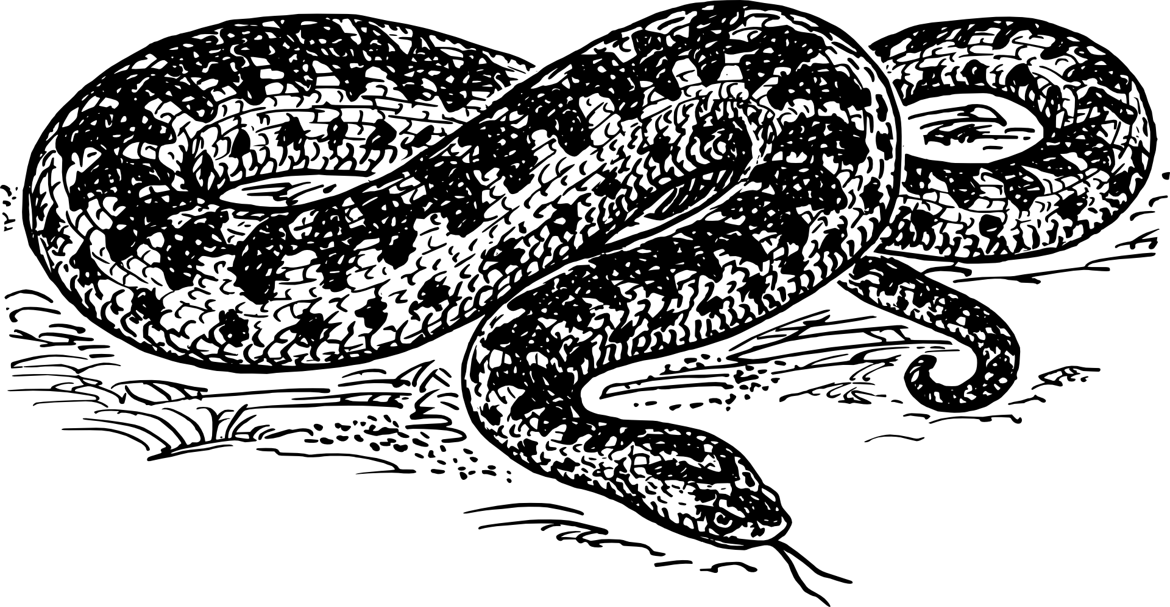
Python Day Intermediate Workshop
WiFi Network: Guest | No Password
Please open https://repl.it and http://bit.ly/scpdi

Slide 2
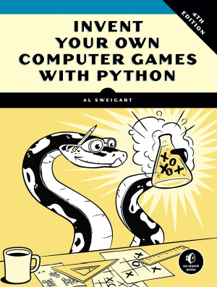
Python Day – Intermediate Workshop
Based on “Invent Your Own Computer Games with Python” – Chapter 13
Get the full book (or read it free online) at https://inventwithpython.com/invent4thed

Slide 3


Slide 4

The Treasure Hunt

Slide 5

The Treasure Hunt

Slide 6
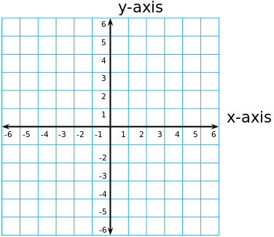
Concept: Cartesian Coordinates

Slide 7
Concept: Cartesian Coordinates

Slide 8
Concept: Cartesian Coordinates

Slide 9
Concept: Lists
In Python a list is a variable that can hold
multiple other variables... including other lists.
x = [] # empty list
y = [ "potato" , 78 , "hut" , "hike" ]
z = [ [ 1 , 2 ] , ["apple" , "orange"] ]
Lists start counting at 0
y[0]’s value is “potato”
z[1][0]’s value is “apple”

Slide 10
# Sonar Treasure Hunt
import random
import sys
import math
def getNewBoard():
# Create a new 60x15 board data structure.
board = []
for x in range(60): # The main list is a list of 60 lists.
board.append([])
for y in range(15):
# Each list in the main list has 15 single-character strings.
# Use different characters for the ocean to make it more readable.
if random.randint(0, 1) == 0:
board[x].append('~')
else:
board[x].append('`')
return board

Slide 11
Concept: Pythagorean Theorem
A² + B² = C²
4² + 3² = C²
B
16 + 9 = 25
4² + 3² = 5²
A
C

